Slide 1
Deep Learning
Artificial Neural Network
Shreyanth H G

Slide 2
Artificial Neural Networks
Computational models inspired by the human brain:
Algorithms that try to mimic the brain.
Massively parallel, distributed system, made up of simple processing units (neurons)
Knowledge is acquired by the network from its environment through a learning process

Slide 3
History
late-1800's - Neural Networks appear as an analogy to biological systems
1960's and 70's – Simple neural networks appear
Fall out of favor because the perceptron is not effective by itself, and there were no good algorithms for multilayer nets
1986 – Backpropagation algorithm appears
Neural Networks have a resurgence in popularity
More computationally expensive

Slide 4
Applications of ANNs
ANNs have been widely used in various domains for:
Pattern recognition
Image recognition
Medical diagnosis

Slide 5
Properties
Inputs are flexible
any real values
Highly correlated or independent
Target function may be discrete-valued, real-valued, or vectors of discrete or real values
Outputs are real numbers between 0 and 1
Resistant to errors in the training data
Long training time
Fast evaluation
The function produced can be difficult for humans to interpret

Slide 6
When to consider neural networks
Input is high-dimensional discrete or raw-valued
Output is discrete or real-valued
Output is a vector of values
Possibly noisy data
Form of target function is unknown
Human readability of the result is not important
Examples:
Speech phoneme recognition
Image classification
Financial prediction

Slide 7
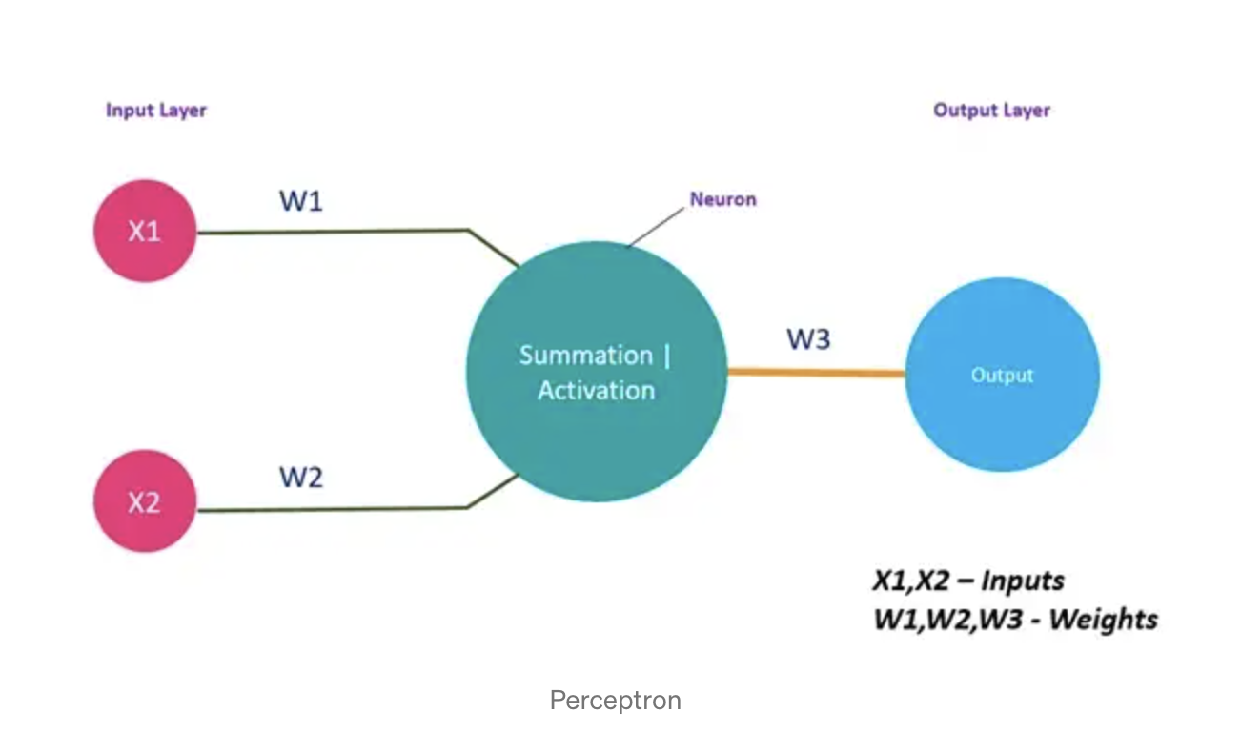
Perceptron

Slide 8
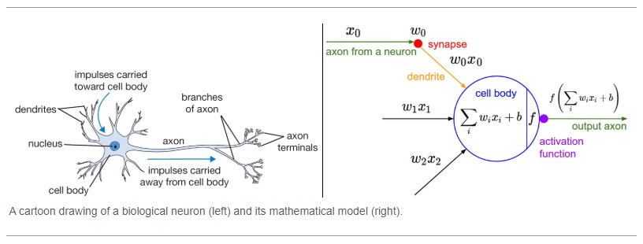
Perceptron

Slide 9
Perceptron
Basic unit in a neural network
Linear separator
Parts
N inputs, x₁ ... x_{n}
Weights for each input, w₁ ... w_{n}
A bias input x₀ (constant) and associated weight w₀
Weighted sum of inputs, y = w₀x₀ + w₁x₁ + ... + w_{n}x_{n}
A threshold function or activation function,
i.e 1 if y > t, -1 if y <= t

Slide 10
Artificial Neural Networks (ANN)
Model is an assembly of inter-connected nodes and weighted links
Output node sums up each of its input value according to the weights of its links
Compare output node against some threshold t

Slide 11
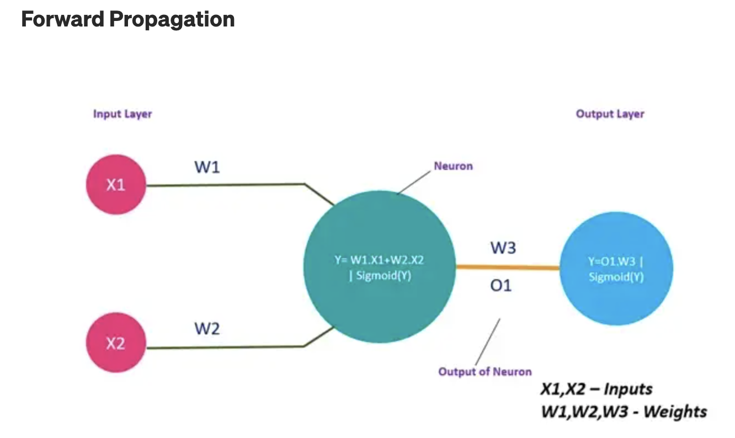
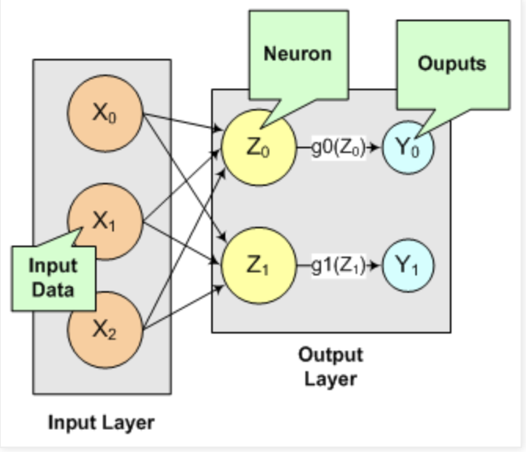
Different Network Topologies
Single layer feed-forward networks
Input layer projecting into the output layer
Single layer
network

Slide 12
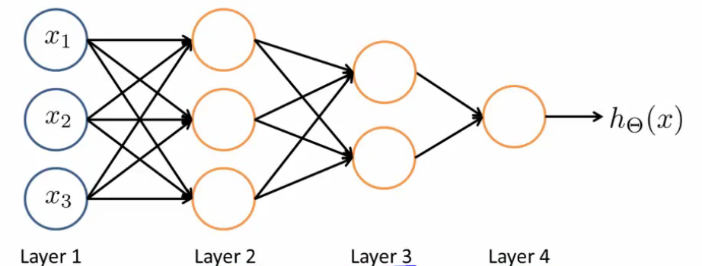
Different Network Topologies
Multi-layer feed-forward networks
Input Hidden Output
layer layers layer

Slide 13
Algorithm for learning ANN
Initialize the weights (w₀, w₁, …, w_{k})
Adjust the weights in such a way that the output of ANN is consistent with class labels of training examples
Error function:
Find the weights w_{i}’s that minimize the above error function
e.g., gradient descent, backpropagation algorithm

Slide 14
Cost function
1. Binary Classification Loss Functions
Binary Cross-Entropy
Hinge Loss
Squared Hinge Loss
2. Multi-Class Classification Loss Functions
Multi-Class Cross-Entropy Loss
Sparse Multiclass Cross-Entropy Loss
Kullback Leibler Divergence Loss

Slide 15
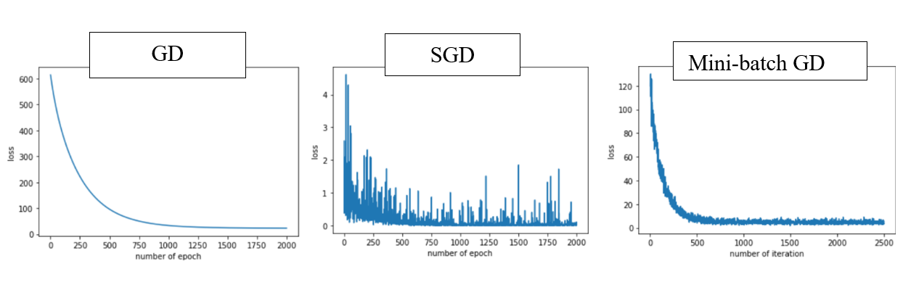
optimizers

Slide 16
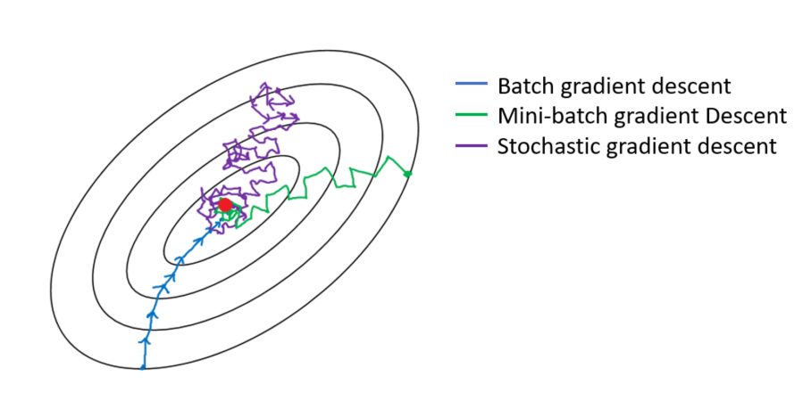

Slide 17
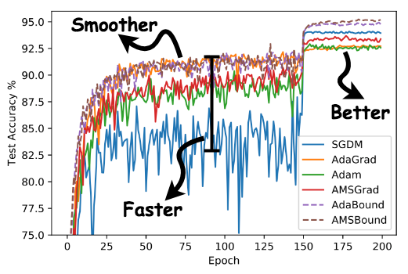

Slide 18
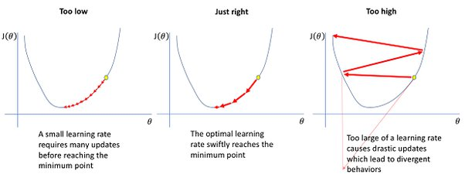
learning rate

Slide 19
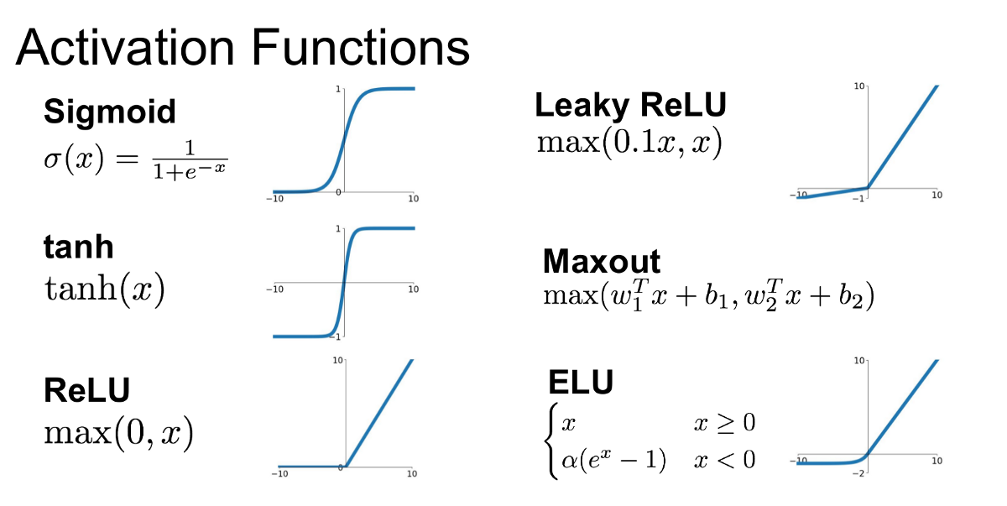

Slide 20
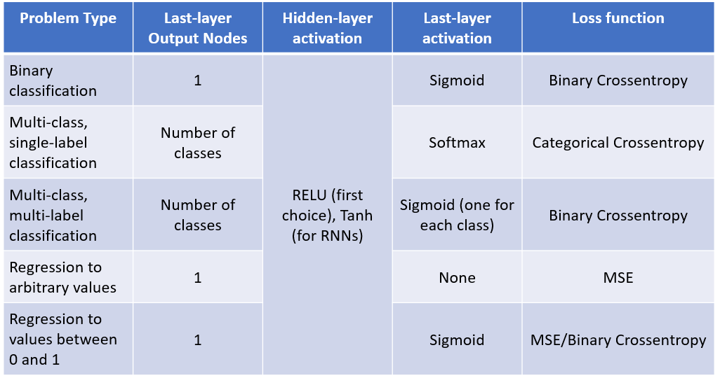
Scenarios to use Activation Function ?

Slide 21
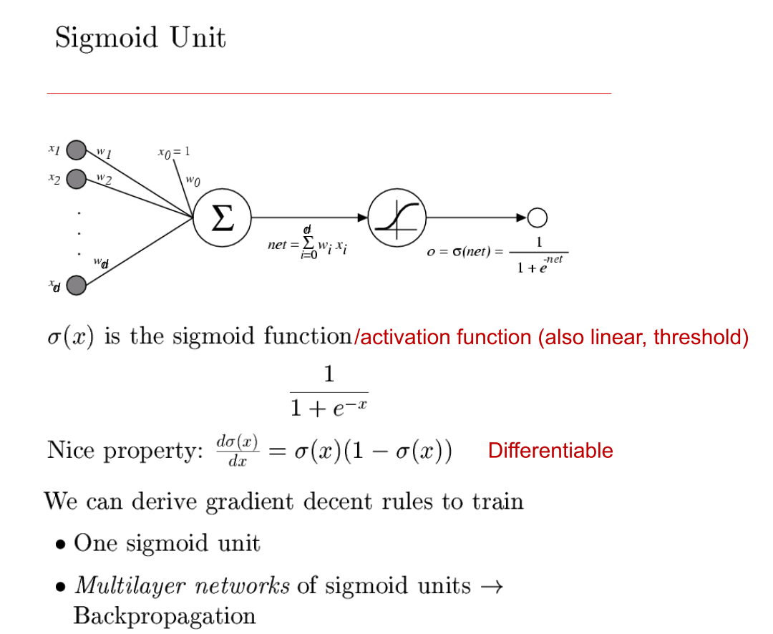

Slide 22
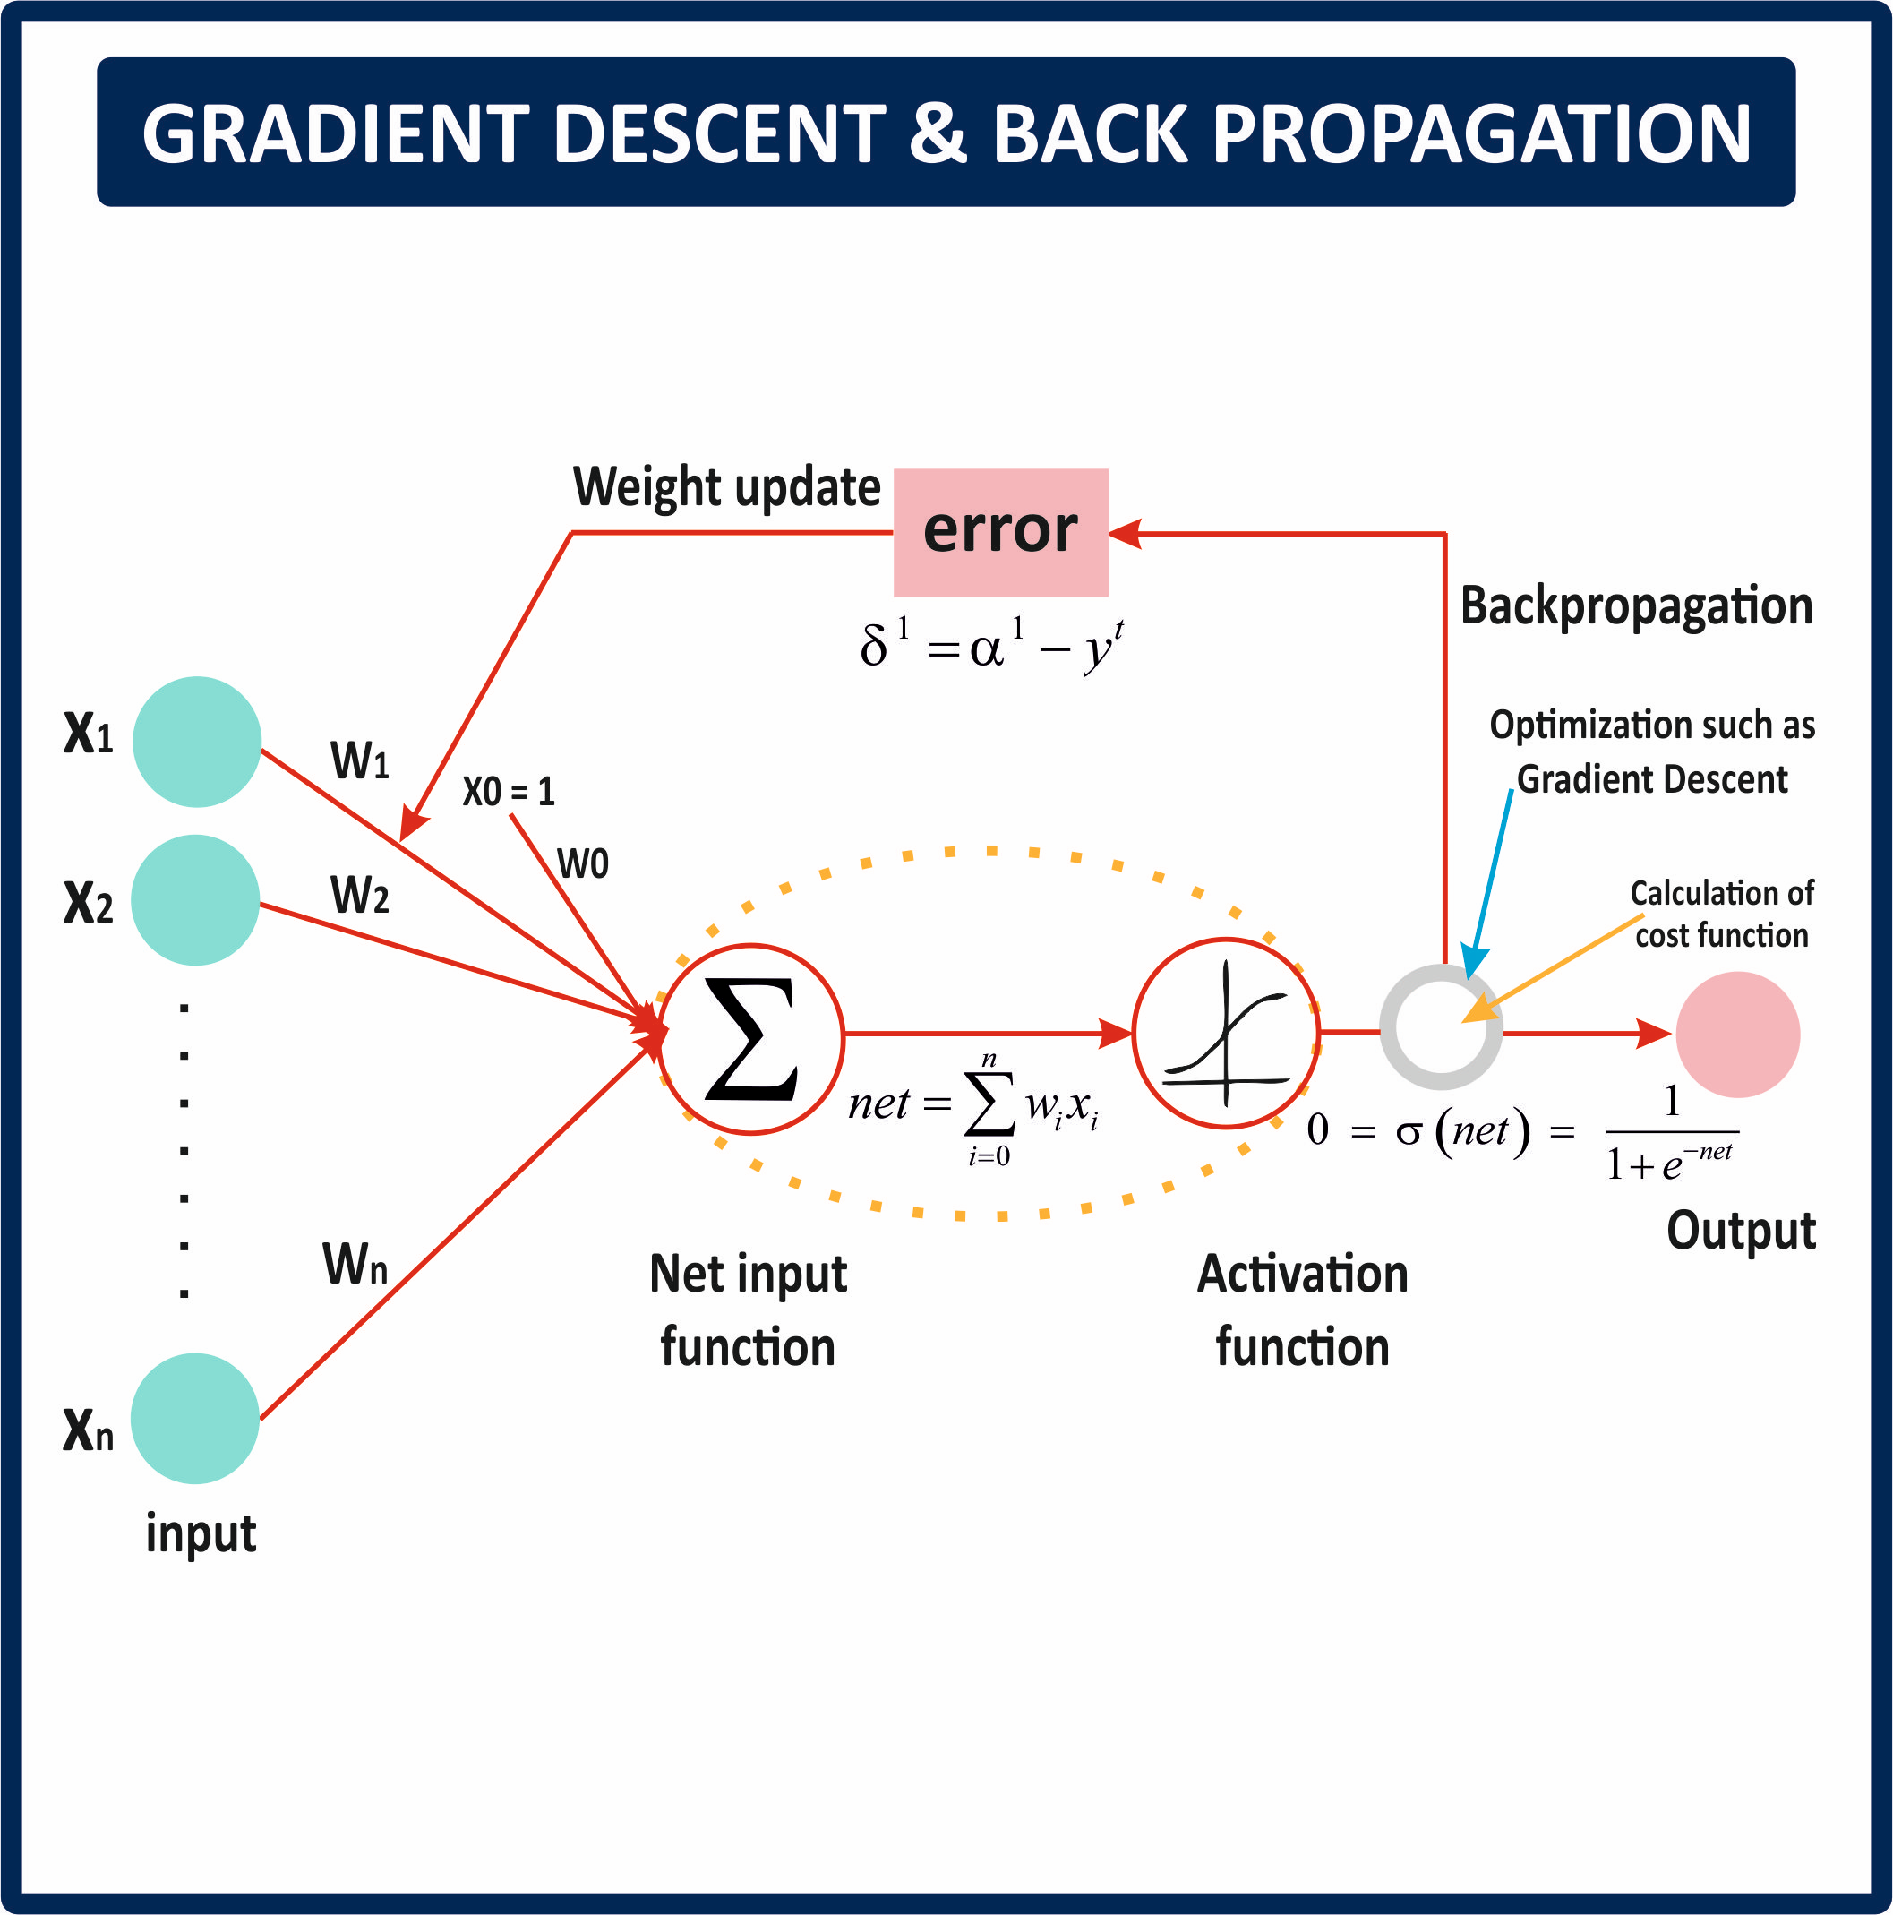

Slide 23
Backpropagation
Iteratively process a set of training tuples & compare the network's prediction with the actual known target value
For each training tuple, the weights are modified to minimize the mean squared error between the network's prediction and the actual target value
Modifications are made in the “backwards” direction: from the output layer, through each hidden layer down to the first hidden layer, hence “backpropagation”
Steps
Initialize weights (to small random #s) and biases in the network
Propagate the inputs forward (by applying activation function)
Backpropagate the error (by updating weights and biases)
Terminating condition (when error is very small, etc.)
Notes:
23

Slide 24
How A Multi-Layer Neural Network Works?
The inputs to the network correspond to the attributes measured for each training tuple
Inputs are fed simultaneously into the units making up the input layer
They are then weighted and fed simultaneously to a hidden layer
The number of hidden layers is arbitrary, although usually only one
The weighted outputs of the last hidden layer are input to units making up the output layer, which emits the network's prediction
The network is feed-forward in that none of the weights cycles back to an input unit or to an output unit of a previous layer
Notes:
24

Slide 25
Neural Network as a Classifier
Weakness
Long training time
Require a number of parameters typically best determined empirically, e.g., the network topology or “structure.”
Poor interpretability: Difficult to interpret the symbolic meaning behind the learned weights and of “hidden units” in the network
Strength
High tolerance to noisy data
Ability to classify untrained patterns
Well-suited for continuous-valued inputs and outputs
Successful on a wide array of real-world data
Algorithms are inherently parallel
Techniques have recently been developed for the extraction of rules from trained neural networks
Notes:
25

Slide 26
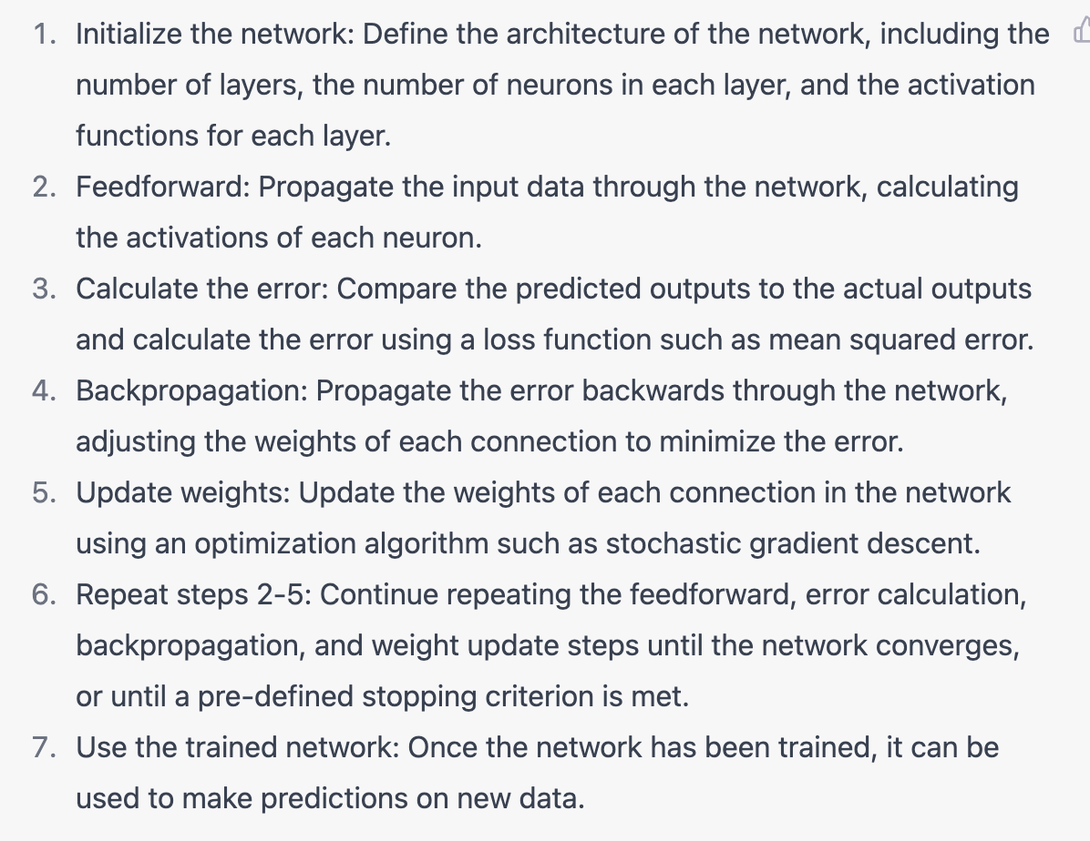
ANN algorithm

Slide 27
Important points to remember in ANN
ANN is prone to Overfitting on training data: To overcome that we should use large data
You could alter the batch size and Epochs of ANN training to improve training time and optimise
A larger batch would train the neural network faster per epoch, but need more memory.
Smaller batch size would take more epochs to train the network but requires less memory

Slide 28
Important points to remember in ANN
Data is increased by augmenting it for better learning in image classification
If data is not scaled correctly, it can result in suboptimal model
ANN classifier is prone to data imbalance
To overcome the data imbalance, we can use SMOTE, etc.
Regularisation techniques such as dropout and weight decay can help prevent Overfitting in ANN

Slide 29
Advantages
Ability to learn from complex data which are large
Robustness and fault tolerance
Generalisation
Parallelism
Nonlinear modelling
Flexibility
Storing information on entire network
Capability to work with incomplete knowledge

Slide 30
Disadvantages
Ann requires lot of data and computational power.
Neural network model is hard to explain, as it belongs to black box model
Data preparation for neural network models needs careful attention
Optimising neural network model for production can be challenging. If it is not optimised carefully. It might lead to slow and unstable model.
Difficulty in showing the problem in the network
Sharing it is difficult

Slide 31
THANK YOU

